Slide 1
Car accident severity solution

Slide 2
Introduction
Collisions in junctions can have two consequences: property damage or/and injury Collisions in junctions cause long delay.
Increase traffic congestion.
Incurs costs that can be avoided.
Simple measures can reduce collision risks.
Exploratory data analysis and predictive modelling can help provide insight to involved parties who can implement safety measures to reduce risk of a collision

Slide 3
Data Wrangling
Use given data by the course on road collisions for Seattle City
Read data into correct format and clean accordingly
Remove duplicate or columns with same elements but which are either in categorical or numerical variables
Remove the Null values
Use get dummies for conversion.

Slide 4
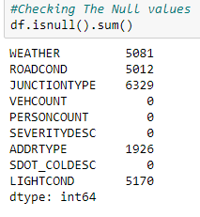
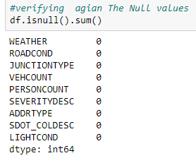

Slide 5
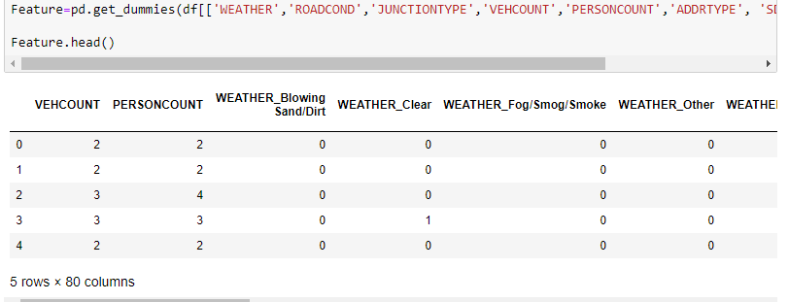
Encoding categorical values
Here, The categorical values are encoded to numericakl using get dummies.

Slide 6
Model Development and Evaluation
Import libraries and modules to perform
Train_test_split
Random Forest Classifier
Metrics

Slide 7
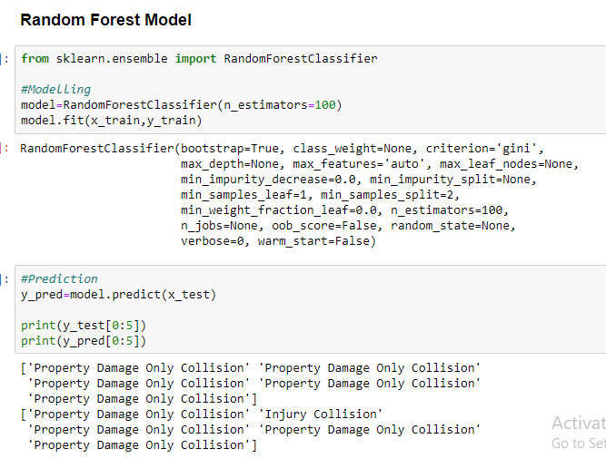

Slide 8
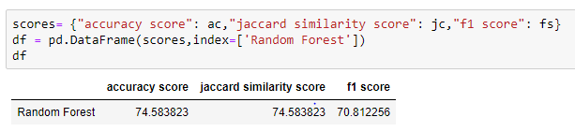
Evaluation Scores

Slide 9
Conclusion
Drop missing values if the range is between 5-10% of the total rows.
Work with categorical attributes using get dummiesto solve the issue
Use Random Forest technique for classification model
This project aimed at exploring the data to provide insight in severity levels for road collisions at junctions. The predictive model would be useful to help local authorities decide on whether to implement new safety measures in certain areas

